Slide 1
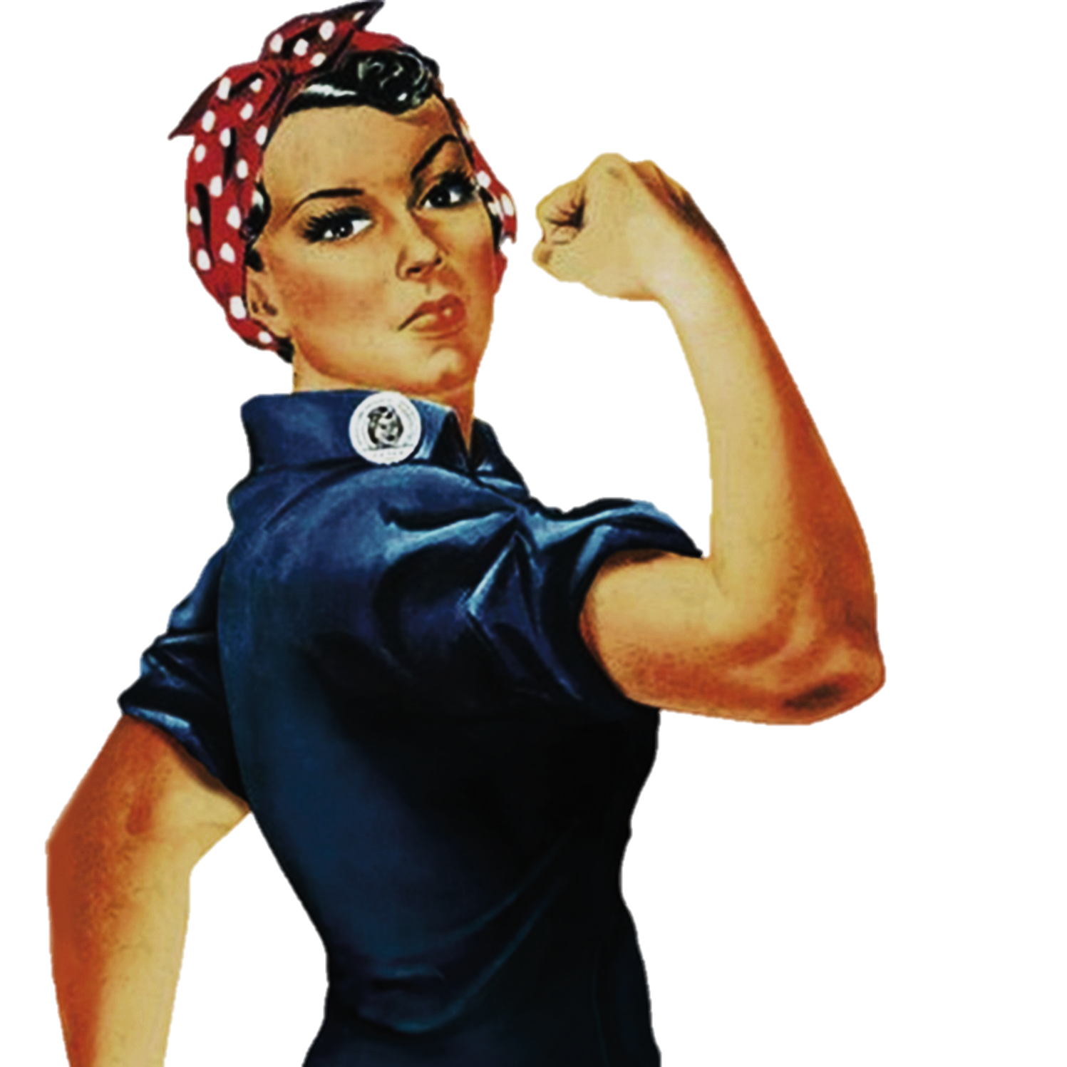
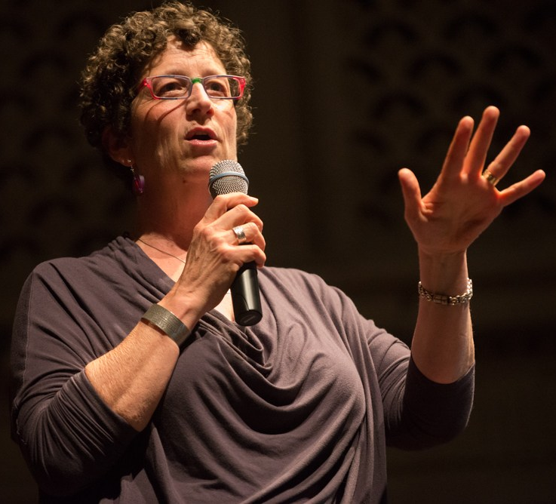

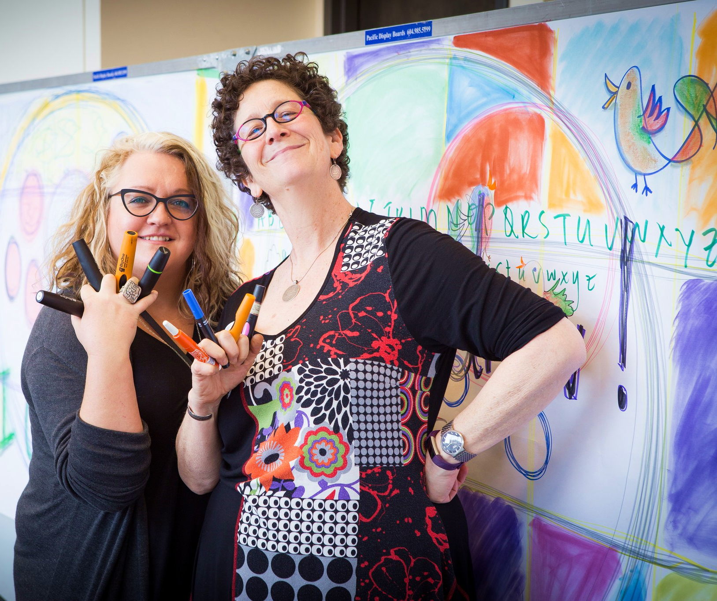
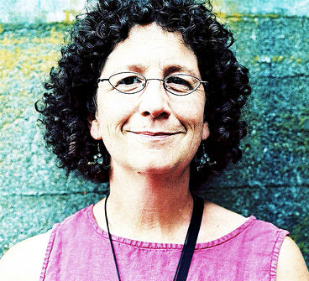
Women
Nancy White @NancyWhite #KM
To change pictures:
Save the picture of the person you wish to use.
Single-left-click the grouped picture/shapes you wish to change on the poster. Single-left-click again on the picture.
Now single-right-click the picture and select “Change Picture” from the menu.
Choose the picture file you saved.
You may wish to single-left-click the grouped picture/shapes and single-left-click the new picture again to adjust its size or crop it—especially useful if the new picture is not the same aspect ratio as the previous one.
DO NOT CHANGE ROSIE THE RIVETER PICTURE!!!
In Technology
1990s-2000s: Early research on Web 2.0 – revolutionary emphasis on user-generated content, interoperability, & usability
2009: Authored the book “Digital Habitats: Stewarding Technology for Communities”
2013: Named #8 on the list of Top 100 Influencers in #KM – Knowledge Management
An avid blogger, writer, drawer, speaker, facilitator, teacher, and twitter-er; Nancy is renowned for her expertise in design, deploy- ment, and nurturing of productive online and offline interaction spaces. Her impact is felt all over the web wherever there are strategic collaborations, virtual conferences, or workgroups.
Nancy sums up her philosophy on #KM with these principles:
CONNECT people with ideas, information, services, and other people COLLABORATE utilizing the full skills, knowledge, and experiences of each player DISCERN the right tools and techniques for the right solution LEARN from every encounter
ENJOY the work and REWARD yourself (sometimes with chocolate!)
How will your expertise in #KM connect people and lead to solutions?

